Slide 1


Flipkart Sales & Performance Analysis Dashboard
Comprehensive E-commerce Business Insights (2020–2025)

Slide 2

Objective & Overview
This comprehensive analysis examines Flipkart's sales performance, profitability trends, and customer behavior patterns across a five-year period from 2020 to 2025.
Our dashboard provides actionable insights derived from 100,000 total orders, analyzing revenue streams, cost structures, geographic performance, and product category dynamics to inform strategic business decisions.
Key focus areas include quarterly profit trends, regional market penetration, customer ordering patterns, and category-level performance metrics.

Slide 3

Data Collection
»The dataset was sourced from Kaggle, an open data platform widely used for analytics and machine learning projects.
» Dataset Name: Flipkart E-Commerce Sales Data (2020–2025)
» The dataset contained over 100,000+ records and 20+ attributes, including: Order ID, Product Name, Category, Brand, State, City, Order Date, Revenue, Profit, COGS, Rating, Payment Mode, and Delivery Days.
» Data represents customer transactions from multiple product categories across Indian states and cities.
» The goal was to analyze sales trends, profit margins, order patterns, and customer behavior over time.

Slide 4

Data Cleaning & Preparation
» Removed Missing Values:
Checked for blanks and null entries in key columns (Revenue, Profit, Category, Payment Mode).Replaced or removed incomplete rows.
» Handled Duplicates:
Identified and removed duplicate Order IDs to ensure unique transactions.
» Standardized Data Formats:
Converted Order Date to proper date format (DD-MM-YYYY).Standardized text fields (e.g., “COD” vs “Cash on Delivery”).
» Calculated Derived Metrics:
Added new columns for Profit Margin (%), Month, and Quarter for time-based analysis.
» Outlier Treatment:
Reviewed unusually high or negative revenue/profit values and adjusted or excluded outliers after verification.
» Categorical Cleanup:
Normalized product categories and payment mode names for consistency.
» Final Data Validation:
Verified total orders, sales, and profits using Excel pivot summaries to match Kaggle base data.

Slide 5
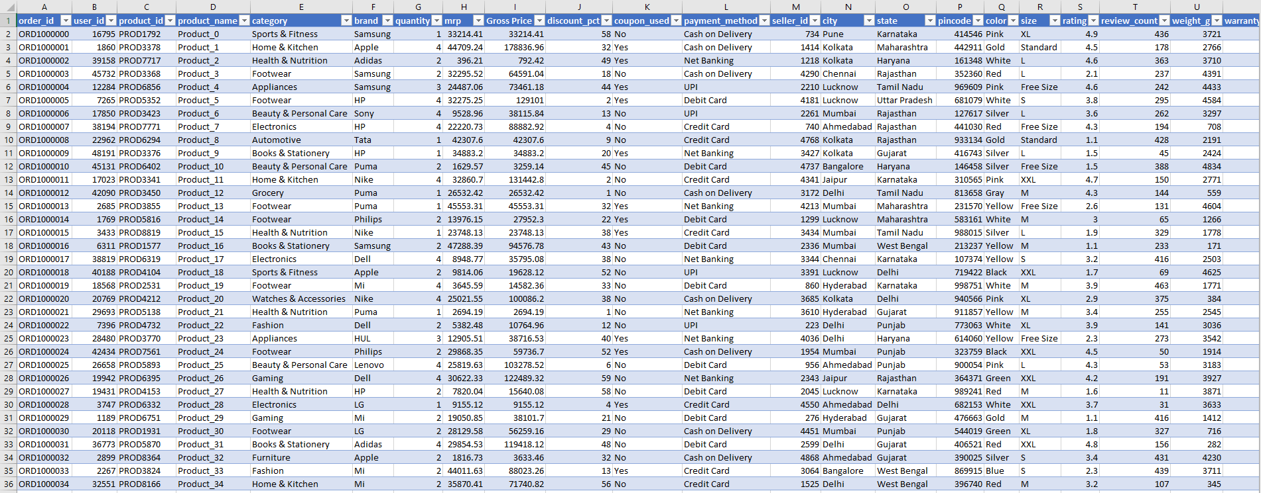
Raw Data

Slide 6
Key Performance Metrics
100K
₹6.3B
₹5.1B
₹1.6B
Total Orders
Total COGS
Total Revenue
Total Profit
Complete dataset analyzed
Cost of goods sold
Generated across period
Net earnings achieved
24.5%
3.0
Profit Margin
Avg Rating
Healthy profitability
Customer satisfaction
These metrics demonstrate strong operational efficiency and consistent profitability across the analyzed period, with a robust profit margin indicating effective cost management and pricing strategies.

Slide 7

Revenue vs Profit Performance
Total Revenue
Total Profit
₹5,067.91 Million generated across all channels and categories
₹1,553.58 Million with exceptional margin consistency
Profit Margin
24.53% maintained throughout the period
The data reveals impressive profitability maintained consistently above 24% across the entire five-year period, demonstrating robust business fundamentals and effective operational management.

Slide 8


Monthly Turnover Analysis
Peak Performance Months
Strategic Insights
1
Monthly turnover ranges from ₹370.76M to ₹459.04M, with July representing peak sales activity.
July
October experienced a notable dip at ₹372.50M, suggesting potential for targeted promotional campaigns during this period.
₹459.04M - Highest monthly turnover
2
The consistent performance across months indicates stable demand and effective inventory management.
January
₹442.47M - Strong year start
3
December
₹370.76M - Holiday season impact

Slide 9

Quarterly Profit Distribution
Q1
Q2
Q3
Q4
Q3 Leads Performance
Consistent Q1-Q3 Performance
Q4 Opportunity Area
Third quarter achieved highest profitability at ₹412.19M (27%) of annual profit
First three quarters maintained steady profit levels between 26-27% each
Fourth quarter at ₹340.12M (22%) presents growth potential for strategic intervention

Slide 10



Order Patterns: Weekday vs Weekend
72%
Weekday Orders
71,635 orders
28%
Weekend Orders
Customer Behavior Insight
28,365 orders
Weekdays dominate order volume, generating 71.7% of total profit. This pattern suggests professional customers shopping during work hours or utilizing lunch breaks for online purchases.
Weekend traffic represents significant opportunity for targeted marketing campaigns and promotional activities to boost conversion rates during off-peak periods.

Slide 11

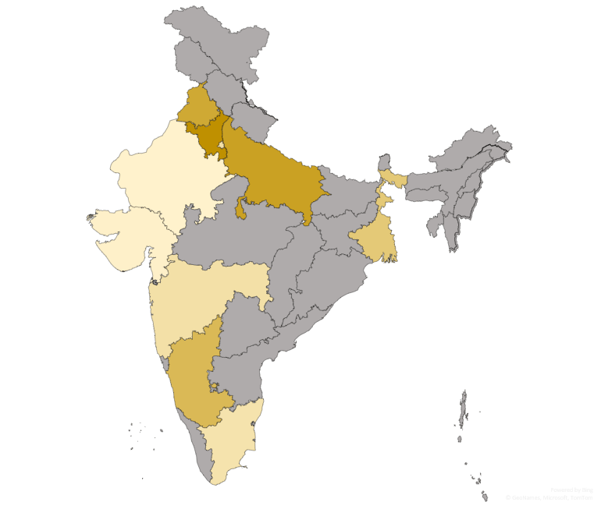
Geographic Performance: State & City Analysis
Top Performing States
Haryana
1
Leading state revenue
Punjab
2
Strong market presence
Karnataka
3
Tech hub advantage
West Bengal
4
Eastern market leader
Maharashtra
5
Metro market strength
Top City Revenue: Single city generated ₹518.67M, representing 10.23% of total revenue, demonstrating strong urban market concentration.

Slide 12




Top 5 Cities Driving Profitability
Kolkata
Jaipur
Mumbai
₹159.28M
₹156.63M
₹156.07M
Eastern India's profit leader
Rajasthan market strength
Financial capital performance
Bangalore
Lucknow
₹135.67M
₹155.38M
Tech city contribution
UP market dominance
These five metropolitan markets collectively contribute 50.4% of total profit, highlighting the strategic importance of urban market penetration and the concentration of high-value customers in tier-1 cities.

Slide 13




Product Category Performance Analysis
Top 5 Revenue Categories
Home & Kitchen
₹346.36M - Leading category
Appliances
₹344.95M - Strong demand
Fashion
₹343.78M - Consistent performer
Sports & Fitness
33.9%
₹341.59M - Growing segment
Footwear
₹341.53M - Competitive category
Top 5 Share
Market capture
66.1%
Others
Long tail potential
Category diversification creates revenue resilience, with top five categories showing balanced performance and significant opportunity in the long-tail segment.

Slide 14

Top 5 Brands by Profit
Nike
₹107.92M
Leader in sportswear
HUL
₹106.49M
Household consumer goods
Philips
₹104.50M
Diverse electronics & health tech
Samsung
₹104.37M
Global tech powerhouse
Dell
₹104.17M
Trusted computing solutions
These five brands collectively demonstrate significant market influence, contributing a substantial portion to overall profitability.
Profit share
The top 5 brands by profit account for 33.9% of the total profit, indicating a strong performance from key partners. The remaining 66.1% is distributed among a long tail of other brands, highlighting the breadth of Flipkart's product offerings.
This distribution suggests both the importance of strategic brand partnerships and the potential for growth across a wider vendor ecosystem.

Slide 15



33.9%
Top 5 Brands
Profit share
66.1%
Other Brands
Profit share

Slide 16











Payment Mode Insights
Understanding customer preferences for payment methods is crucial for optimizing the checkout experience and financial operations.
Credit Card
UPI
₹1,020.82M Revenue
20.1K Transactions
20.06% of all transactions
Net Banking
Debit Card
20K Transactions
20K Transactions
COD
19.9K Transactions
Credit Cards emerge as the leading payment method, contributing the highest revenue and a significant portion of total transactions, indicating a strong preference among high-value customers. Other digital payment methods like UPI, Net Banking, and Debit Cards show very similar transaction volumes, highlighting a diversified digital payment landscape.

Slide 17

Order & Delivery Performance
95,113
4,887
Orders Delivered
Cancellations
High fulfillment success rate
Minimal order disruptions
6
95.12%
Avg. Delivery Days
Stock Clearance
Efficient logistics turnaround
Effective inventory management
237,547
12,189
Products Delivered
Stock Remaining
Vast volume reaching customers
Optimized inventory levels
Operational efficiency is evident with a high volume of delivered orders and products, coupled with a commendable stock clearance rate and efficient delivery times. The low cancellation rate further indicates customer satisfaction and accurate order processing.

Slide 18





Business Insights & Key Takeaways
Weekday Dominance
Credit Card Preference
Q3 Profit Peak
72% of orders occur during weekdays, indicating consistent demand and purchasing habits during the work week.
Credit Cards drive the highest revenue (₹1,020.82M), accounting for over 20% of all transactions.
The third quarter leads in profitability, securing 27% of the annual profit, marking it as a key performance period.
Leading Product Categories
High Delivery Efficiency
Home & Kitchen and Appliances are top revenue generators, contributing significantly to overall sales performance.
95% stock clearance and quick average delivery times reflect robust operational logistics and customer satisfaction.

Slide 19





Recommendations & Conclusion
Based on our comprehensive analysis of Flipkart's sales and performance data, we present key recommendations to drive future growth and optimize operations.
Strategic Expansion
Target and invest in underperforming states to unlock new market potential and broaden reach.
Targeted Marketing
Strengthen marketing efforts for high-margin product categories to maximize profitability and revenue.
Operational Excellence
Continuously improve delivery times and expand product diversity to enhance customer satisfaction and loyalty.
Customer-Centric Growth
Leverage advanced data analytics to develop personalized customer retention strategies and foster long-term engagement.

